Slide 1

Class 7: Beyond ‘Command and Control’
Larry Swatuk
lswatuk@uwaterloo.ca

Slide 2
Fundamental Challenge
Ecosystems are dynamic
But humans want order and predictability
Humans operate within the system but seek to dominate it
But action leads to reaction, often in unexpected ways
If we wish to remain within a particular system, we must recognize boundaries and acknowledge limits
Going beyond boundaries (a known order) will create a new system (an unknown or less well-known disorder)
Adaptation will be necessary (from Holocene to Anthropocene)

Slide 3
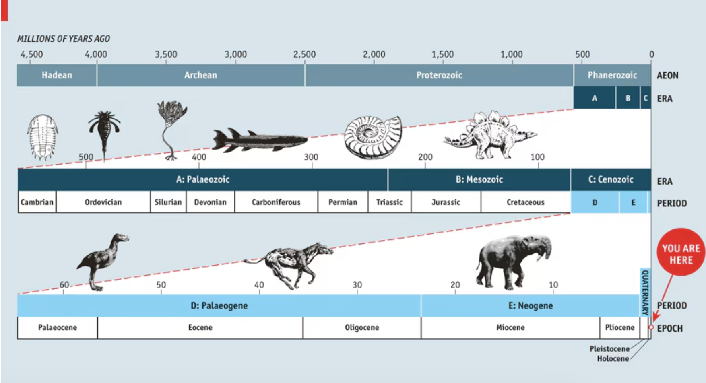

Slide 4
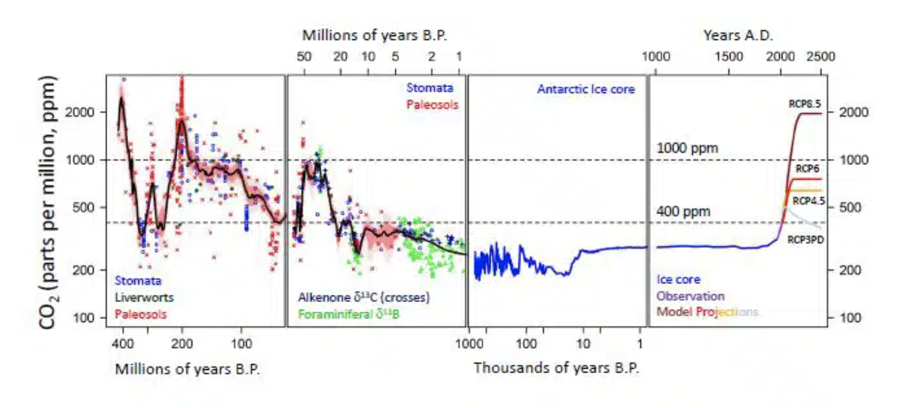

Slide 5
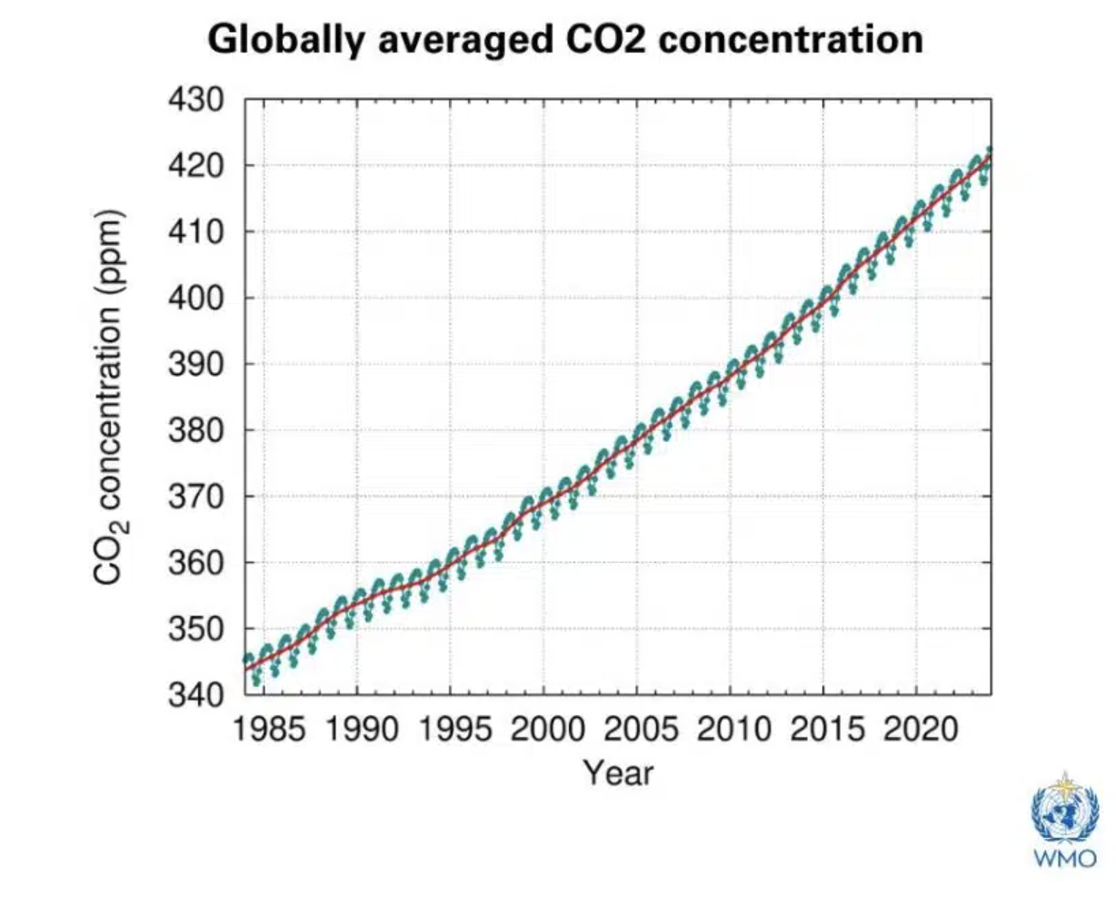

Slide 6
Energy Flow in an Ecosystem
Laws of thermodynamics describe the energy flow in an Ecosystem
1st Law (Law of Conservation of Energy): Energy can not be created or destroyed; it is merely changed from one form into another
2nd Law (Law of Entropy):When energy is transformed from one form into another, there is always a decrease in the quality of usable energy.

Slide 7
Why both laws matter for NRM
Law | What it tells us | NRM implication
First Law | Nothing disappears | Waste, pollution, and emissions are unavoidable
Second Law | Everything degrades | Efficiency, conservation, and prevention matter more than cleanup

Slide 8
From the Holocene to the Anthropocene
Holocene (≈ last 11,700 years)
Relatively stable climate
Energy flows dominated by:
Solar input
Biological processes
Human systems largely embedded within ecosystem limits
Anthropocene (≈ mid-20th century onward)
Rapid, large-scale human redirection of energy and materials
Fossil fuels unlock ancient stored energy
Human systems begin to override natural regulatory processes

Slide 9
Core concepts for socio-ecological systems approach
Sustainability
is not about stopping resource use—it’s about slowing down irreversible degradation.
Conservation
Conserving resources saves high-quality energy and materials for future use.
Circular economy (with limits)
Circular systems help—but thermodynamics tells us they can never be perfectly circular.
Ecosystem services
Ecosystems are energy-processing systems—once degraded, they require large energy inputs to restore (if restoration is even possible).

Slide 10
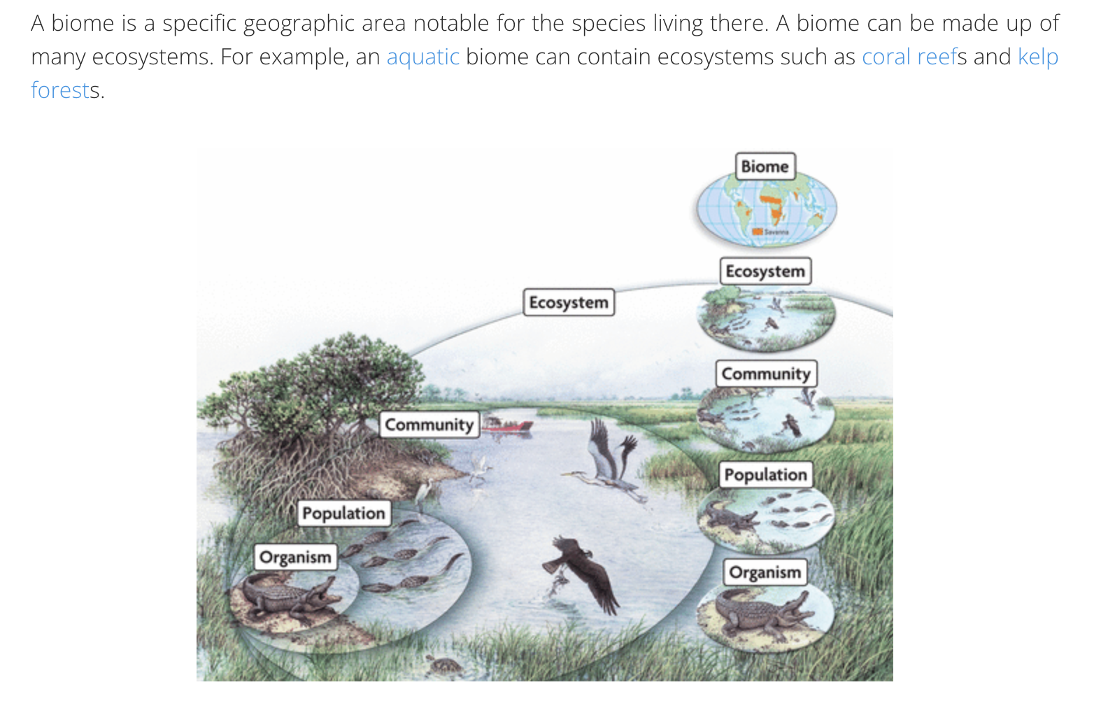

“Nesting” and Categorizing

Slide 11
Level | What it represents | Primary emphasis
Biome | Global ecological pattern | Climate & vegetation form
Ecozone | Large biophysical region | Geological & evolutionary context
Ecoregion | Ecological subdivision | Ecological similarity
Landscape | Spatial mosaic | Human–nature interaction
Ecosystem | Functional unit | Processes & interactions

Slide 12
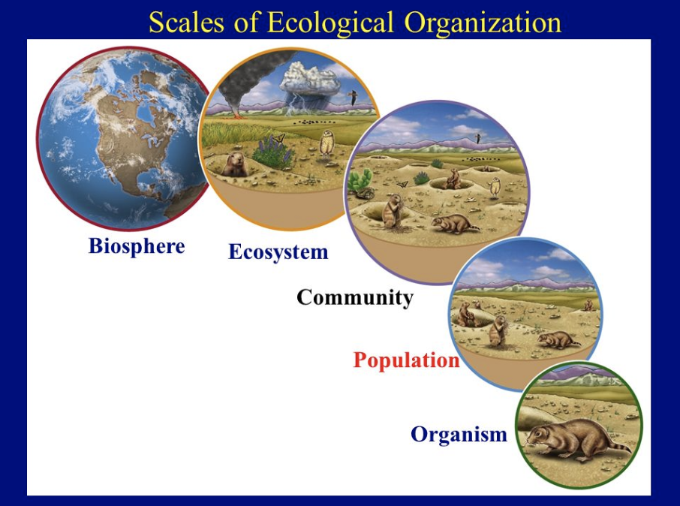

Slide 13
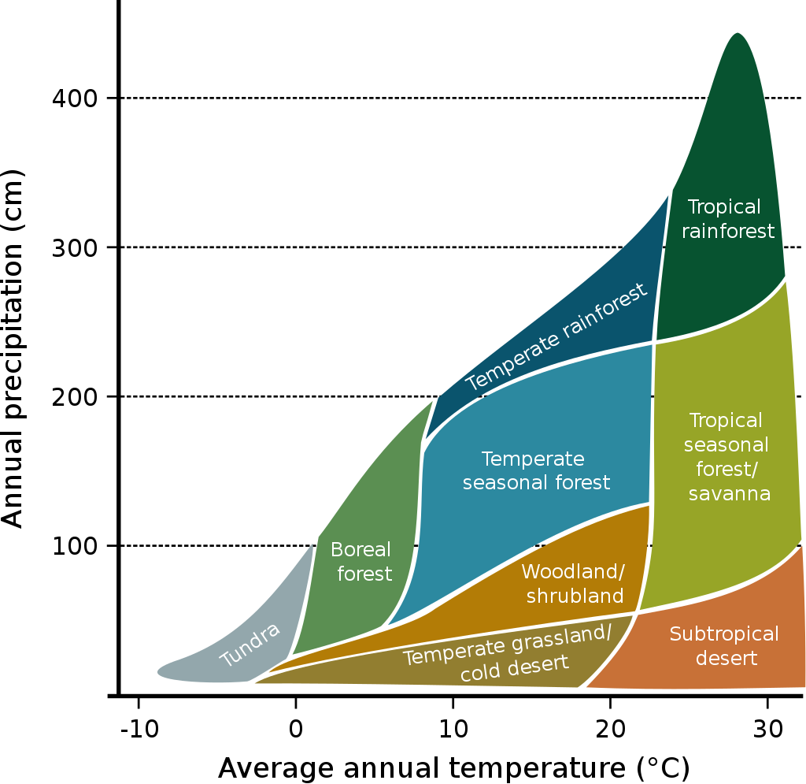
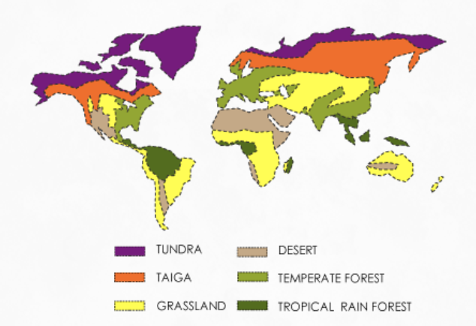
Major Biomes

Slide 14
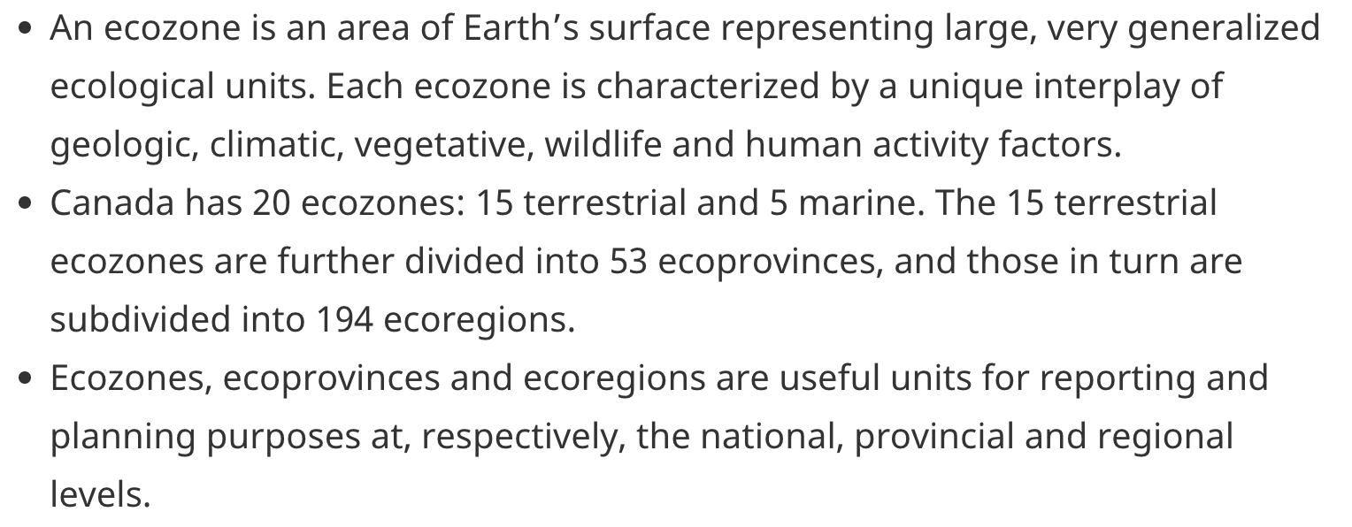
Ecozones

Slide 15
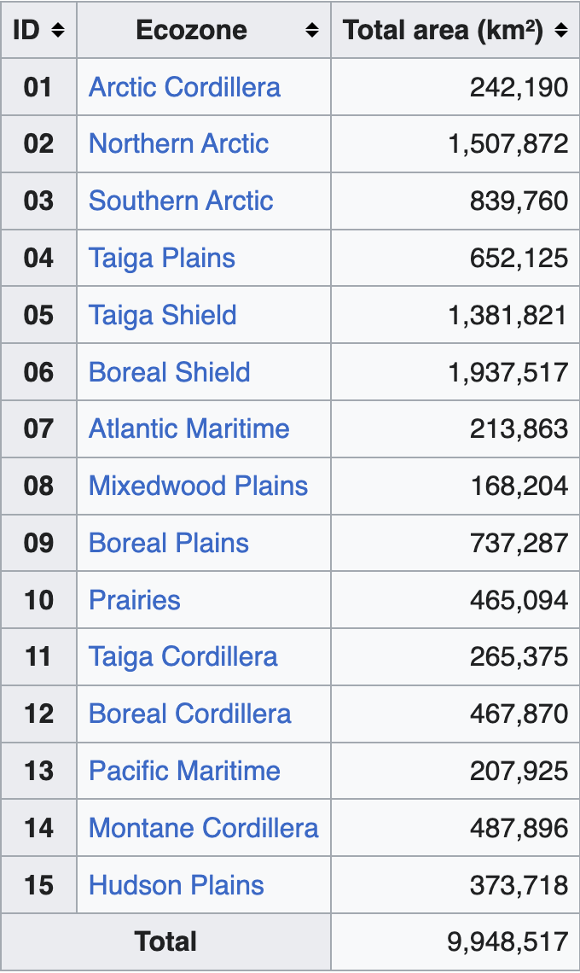
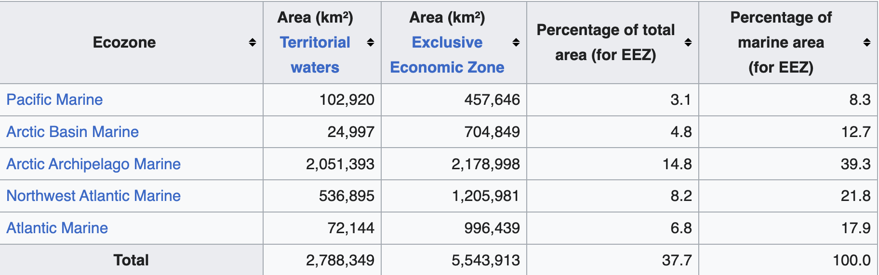
Terrestrial and Marine Ecozones of Canada
Notes:
EEZ = exclusive economic zone

Slide 16
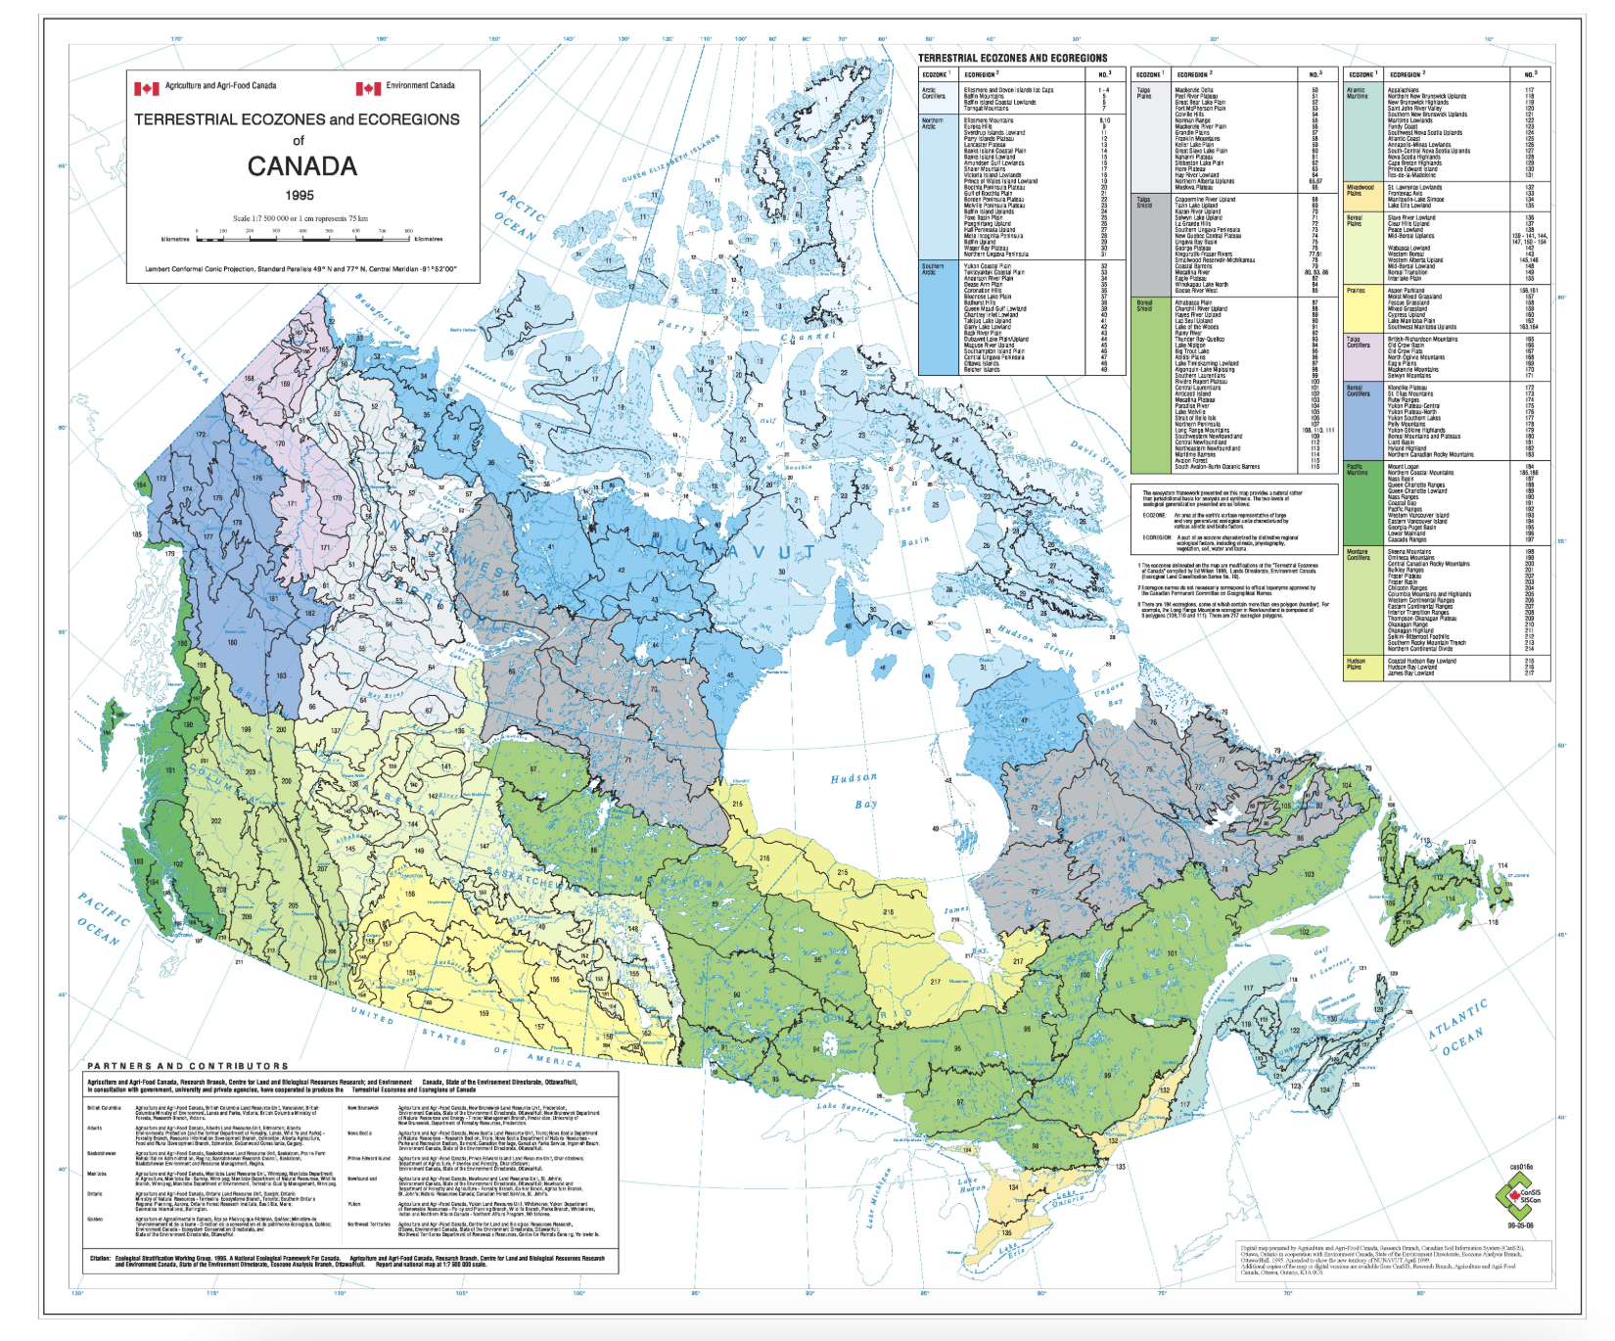
Ecozones & Ecoregions in Canada
Notes:
https://sis.agr.gc.ca/cansis/publications/manuals/1996/cad-map.jpg

Slide 17
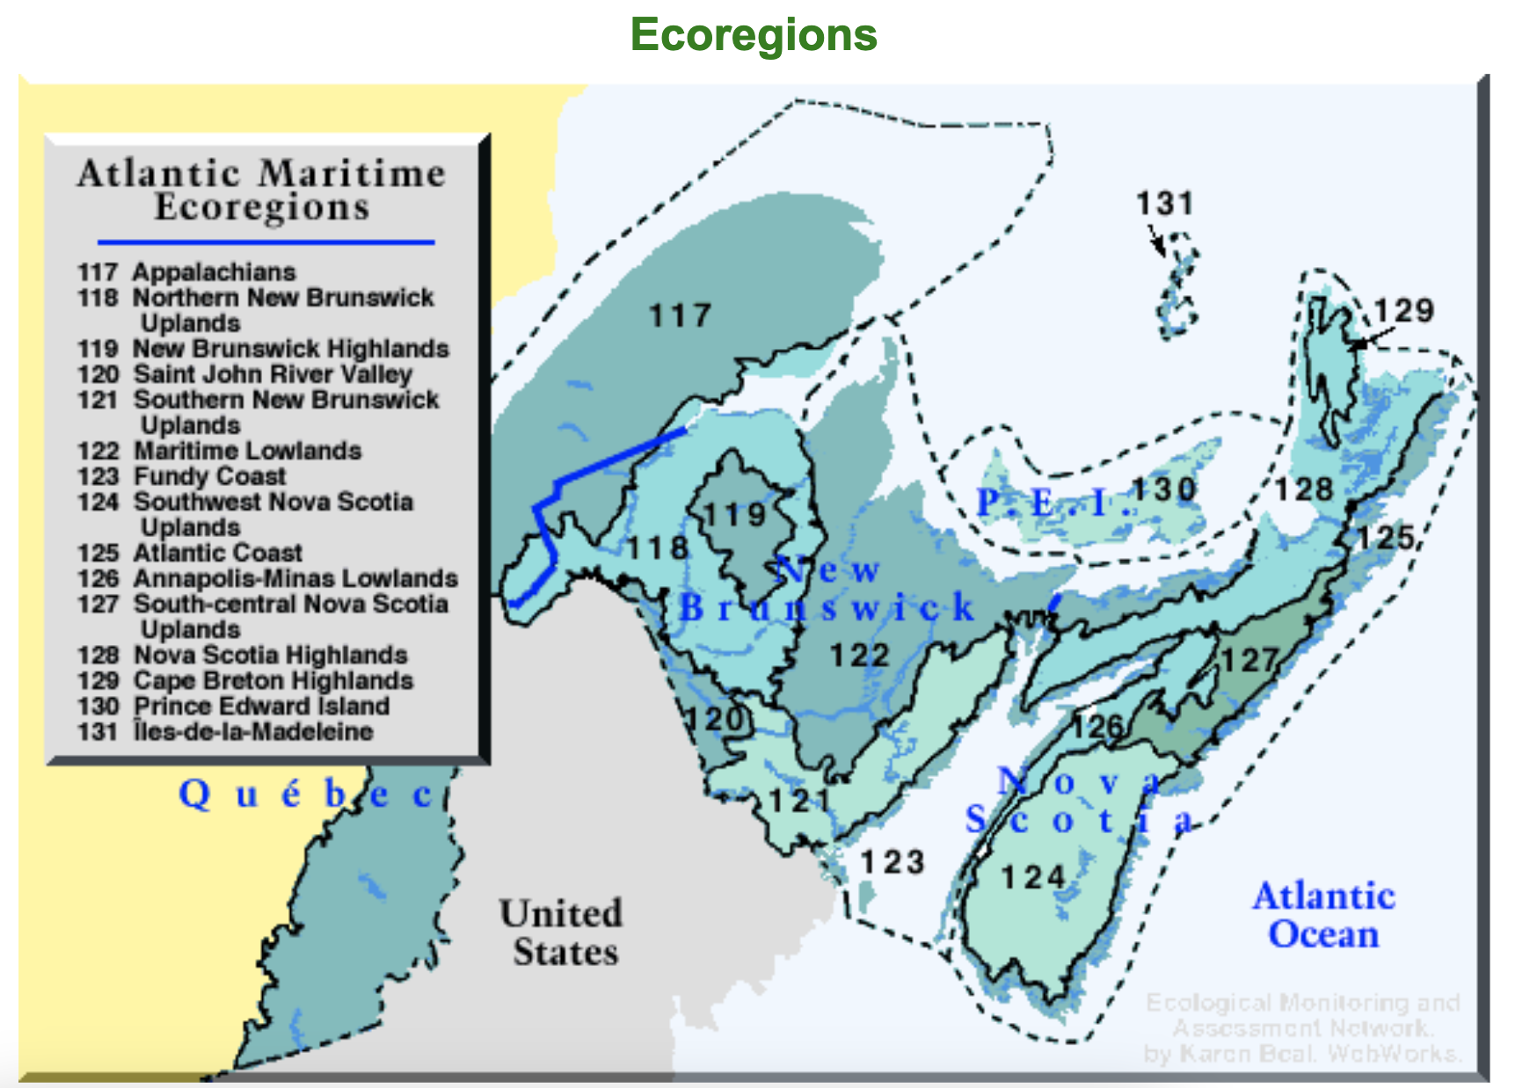

Slide 18
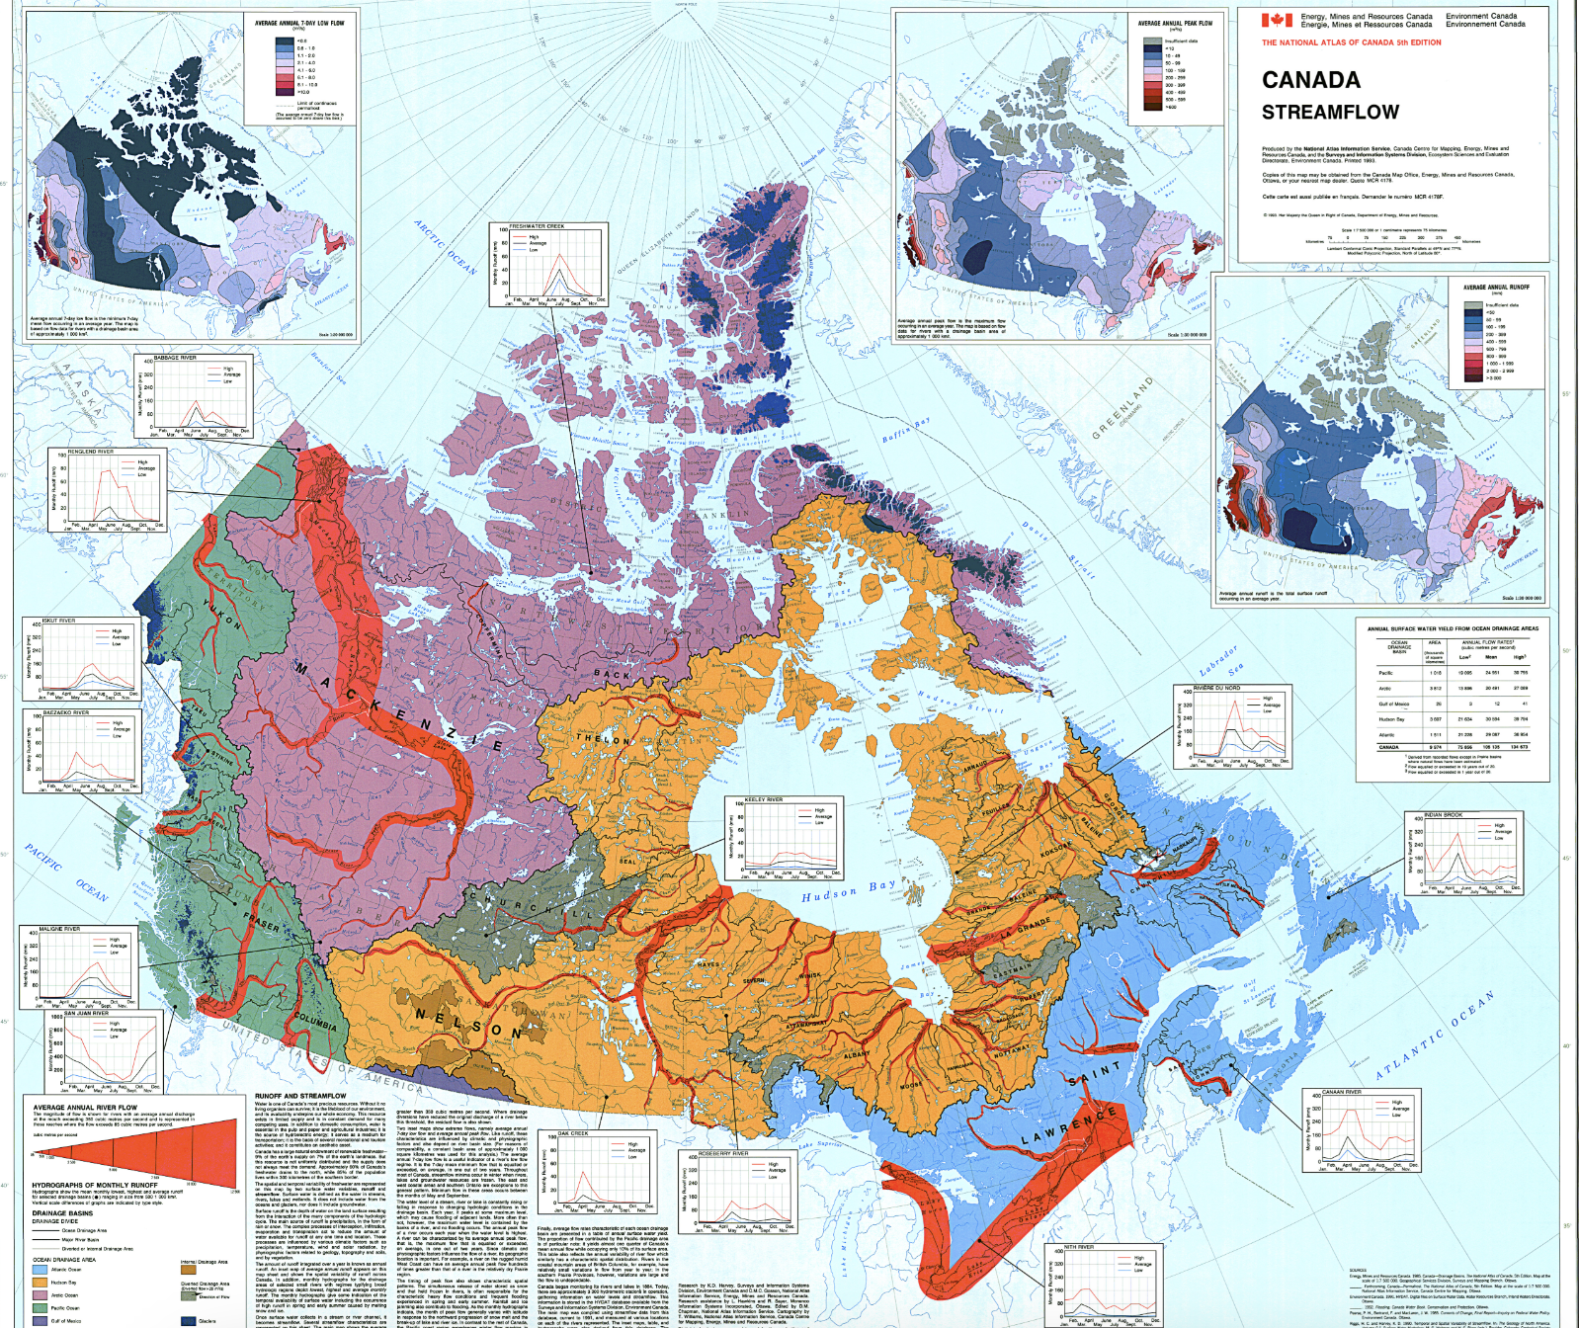
Notes:
https://www.reddit.com/r/MapPorn/comments/eq2322/canadian_watersheds_and_major_river_flow_volume/#lightbox

Slide 19
Ecosystem
Short for ecological system
A community of organisms occupying a given region within a biome, including the physical and chemical environment of that community and all the interactions among and between organisms and their environment.

Slide 20
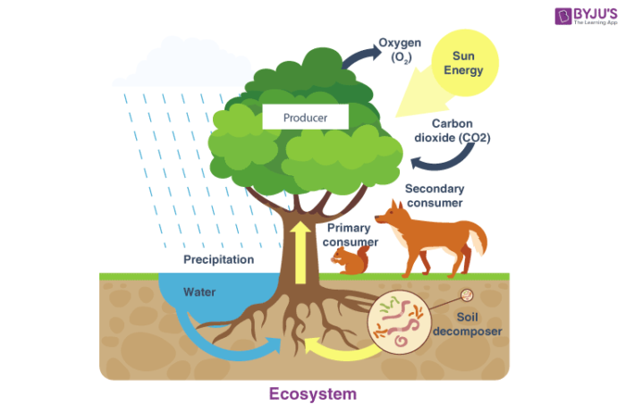
Ecosystem Based Management
Holistic management that takes into account the entire ecosystem and emphasizes biodiversity and ecosystem integrity, as opposed to focusing primarily or solely on a resource or resources, such as water or timber, within an ecosystem.

Slide 21
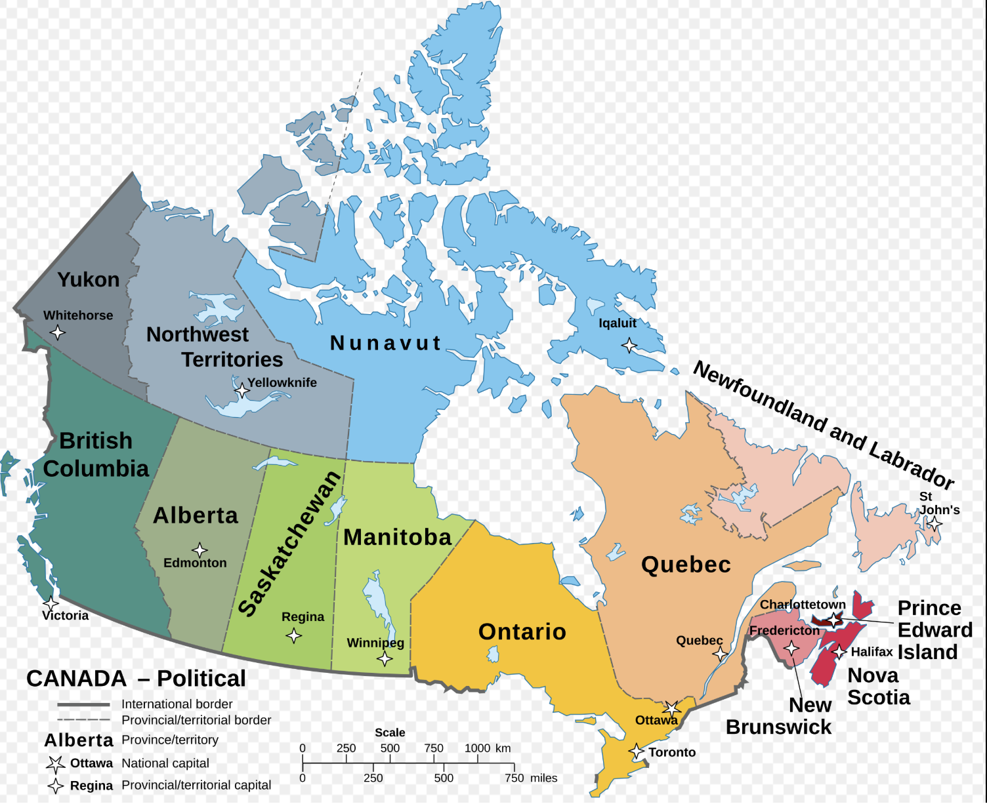

Slide 22
